Slide 1
Why does this matter?
Media should not interrupt or interfere with the academic mission of the University or campus activities, including classes and events.
The rights of students not to be photographed, filmed, or interviewed must be respected.
Columbia’s campus is private property, unlike a state-run school.
Who does this apply to?
Any journalist or reporter for any news outlet – online, print, TV or radio.
Videographers and photographers
Documentary filmmakers

Slide 2
Why does this matter?
Media should not interrupt or interfere with the academic mission of the University or campus activities, including classes and events.
The rights of students not to be photographed, filmed, or interviewed must be respected.
Columbia’s campus is private property, unlike a state-run school.
Who does this apply to?
Any journalist or reporter for any news outlet – online, print, TV or radio.
Videographers and photographers
Documentary filmmakers
Same at CUIMC, but with patients

Slide 3
HIPAA
The Health Insurance Portability and Accountability Act (HIPAA) generally prohibits healthcare providers and businesses, called covered entities, from disclosing Protected Health Information (PHI) to anyone other than a patient without their consent.
Protected Health Information (PHI) is any health-related information that can be used alone, or in combination with other information, to identify an individual.
We follow HIPAA regulations because they're the law, but also because doing so protects our patients and customers.

Slide 4
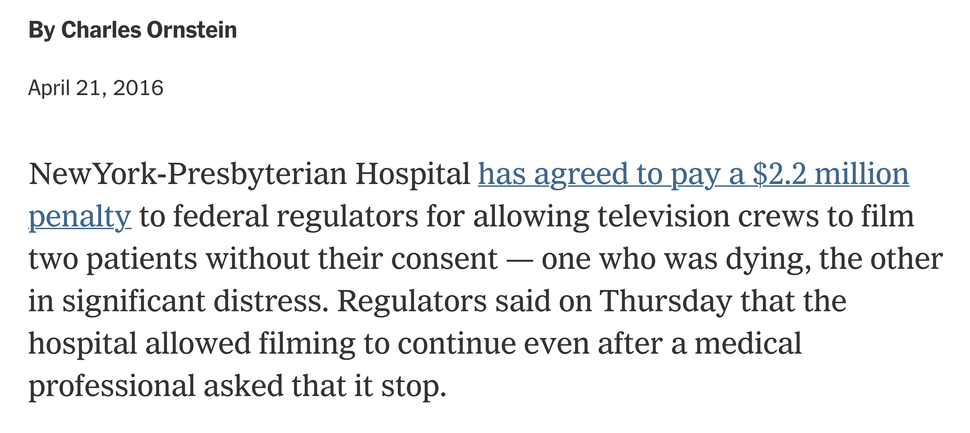
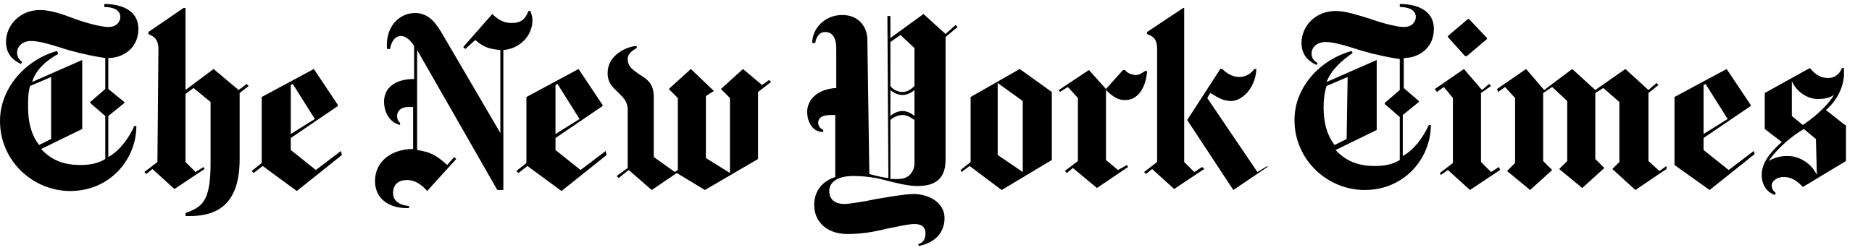
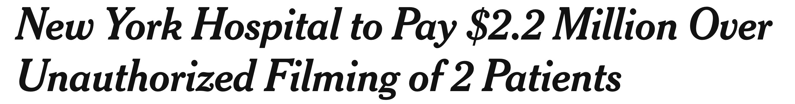

Slide 5
Organizing a HIPAA compliant shoot
Before filming, we need a signed HIPAA form from the patient
All shoots, especially those involving patients must be discussed with the CUIMC media team
Filming locations need to be scouted and cleared for PHI
Notes:
HIPAA release forms are critical
It’s not just about getting a signature… you need to explain to the patient
You need to have a discussion with the comms office. Not just forms that magically clear you of wrong doing.
Questions karen Pagliaro
Even if it clears hipaa and the patient says yes… we may not want to do it… makes other patients uncomfortable, or optics don’t look good.

Slide 6
Other considerations for productions on CUIMC campus
COVID safety – requirements include vaccination, masks, attestation form.
Biosafety – are there any special clearances needed to enter a lab space?
Animal safety – must be cleared by the Committee for Animal Welfare.
Notes:
Biosafety…
COVID we couldn’t do it… (everyone wants to film contagion)… but just isn’t safe…
Animals…
Ethical standards

Slide 7
Types of productions
National and local news
International news
Documentary
TV shows/Movies
Non-profits/foundations/professional societies
Industry
Notes:
News (how much value, is it a feature or a 10 sec soundbyte)
International news (harder to vet) I have a background on 4 continents…
(usually only when profile of researcher by pbs/bbc of home country)
Documentary (harder to vet)… worked with Ken Burns… point is not all the same, do your background research
Industry requests (usually a no)
Non-profit requests (blurry)
Sometimes non-profits
Is it centered on work at Columbia?

Slide 8
Alternatives to filming on-site
Can they do the interview over Zoom?
Will they accept using B-roll filmed internally by Columbia staff?
Can they film the interview offsite?
Notes:
HIPAA release forms are critical
It’s not just about getting a signature… you need to explain to the patient
You need to have a discussion with the comms office. Not just forms that magically clear you of wrong doing.
Questions karen Pagliaro
Even if it clears hipaa and the patient says yes… we may not want to do it… makes other patients uncomfortable, or optics don’t look good.

Slide 9
Core principles for vetting productions
We amplify the amazing work of Columbia faculty, staff, and students
We help provide reporters with access so they can inform the public on important matters
Notes:
I want to emphasize the second point… building trust with reporters
we are not just being difficult for the sake of It
We don’t say yes to everything we need to minimize risk
We need to focus on the genuinely valuable opportunities (takes time, involves risk)

Slide 10
Core principles for vetting productions
We amplify the amazing work of Columbia faculty, staff, and students
We help provide reporters with access so they can inform the public on important matters
BUT we don’t say yes to everything
We are selective because it maximizes our impact
✉️ cumcnews@columbia.edu
Notes:
I want to emphasize the second point… building trust with reporters
we are not just being difficult for the sake of It
We don’t say yes to everything we need to minimize risk
We need to focus on the genuinely valuable opportunities (takes time, involves risk)

